Slide 1
Domain: Salesforce Developer Use Case : Vehicle Management Systems
TEAM MEMBERS GUIDE : Mr.VENKATA RAMANEN
Boojika M MENTOR :Mr.VENKATA RAMANEN
Jayashree A
Rohini B
Sivaranjani P
Vishnu Mithran

Slide 2
What is Salesforce ?
Salesforce a CRM platform and it is a Saas Cloud . Apart from this, it is game-changing technology, with a host of productivity- boosting features, that will help you sell smarter and faster.
Salesforce has everything you need to run your business from anywhere. Using standard products and features, you can manage relationships with prospects and customers, collaborate and engage with employees and partners, and store your data securely in the cloud.
Salesforce is your customer success platform, designed to help you sell, service, market, analyze, and connect with your customers.

Slide 3
What is Vehicle Management System ?
Vehicle management systems created by SCAND are designed to help our clients to keep track of the vehicles in real-time, plan, execute, and optimize their transportation processes through GPS and data collection. Here are some of the services we provide: Fleet management app development.

Slide 4
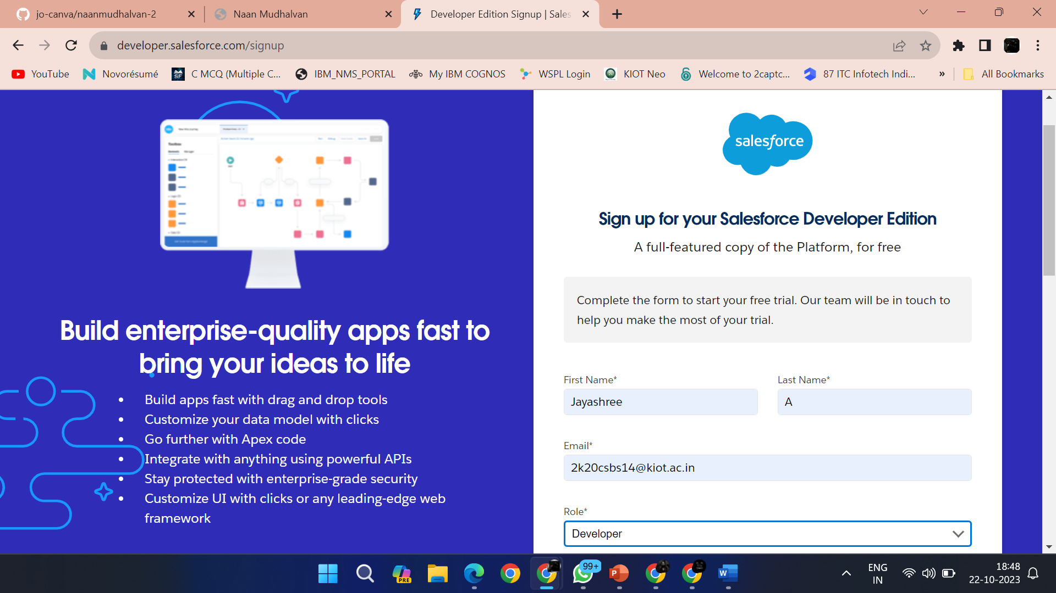
CREATION OF DEVELOPER ACCOUNT
A Developer org has all the features and licenses you need to get started with Salesforce.1.Search Developer.salesforce.com/signup

Slide 5
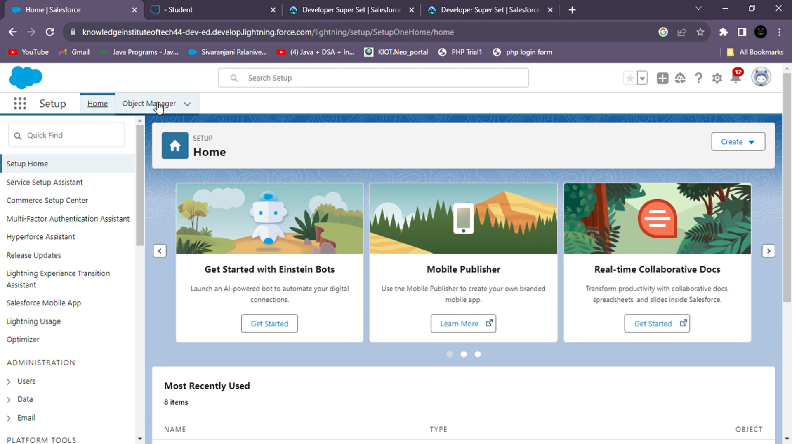
HOME PAGE

Slide 6
WHAT IS AN SALESFORCE OBJECT?
Salesforce objects are database tables that permit you to store data that is specific to an organization. It consists of fields(columns) and records (rows).
SALESFORCE OBJECTS ARE OF TWO TYPES
I . Standard Objects: Standard objects are the kind of objects that are provided by salesforce.com such as users, contracts, reports, dashboards, etc.
Ii . Custom Objects: Custom objects are those objects that are created by users. They supply information that is unique and essential to their organization. They are the heart of any application and provide a structure for sharing data.

Slide 7
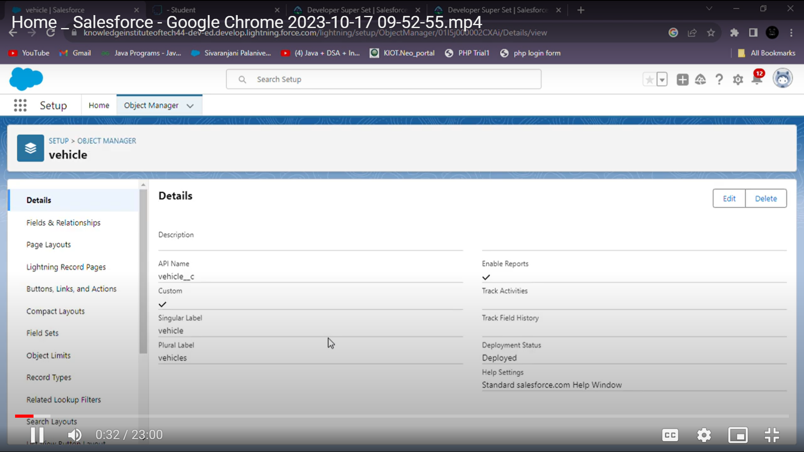
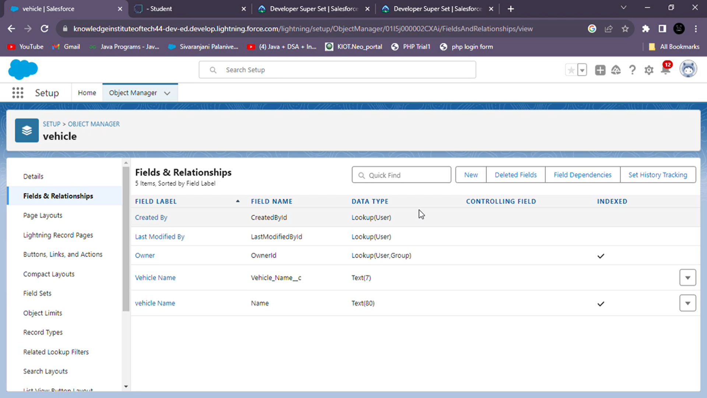

Slide 8
FIELDS AND RELATIONSHIP
What are fields?
Fields in Salesforce represent what the columns represent in relational databases. It can store data values which are required for a particular object in a record.
There are 2 types of fields in salesforce:
Standard fields:
There are four standard fields in every custom object that are Created By, Last Modified By, Owner, and the field created at the time of the creation of an object. These fields cannot be deleted or edited and they are always required. For standard objects, the fields which are present by default in them and cannot be deleted from standard objects are standard fields.
Custom fields:
The Custom fields which are added by the administrator/developer to meet the business requirements of any organization. They may or may not be required.

Slide 9
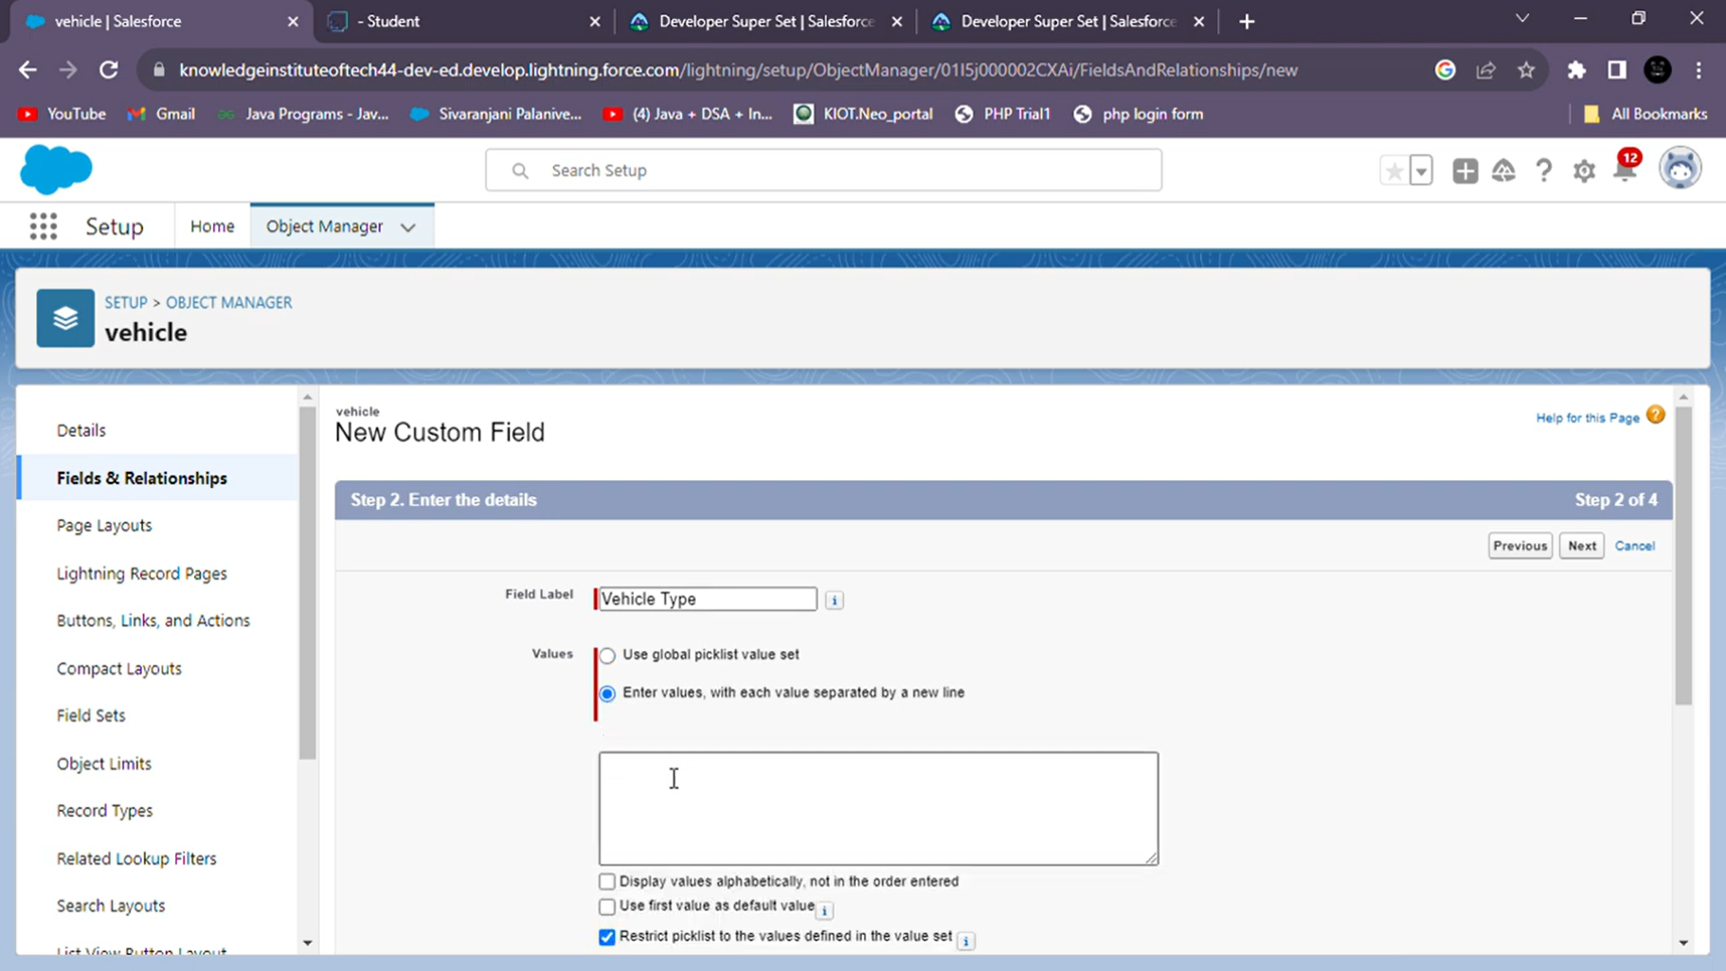
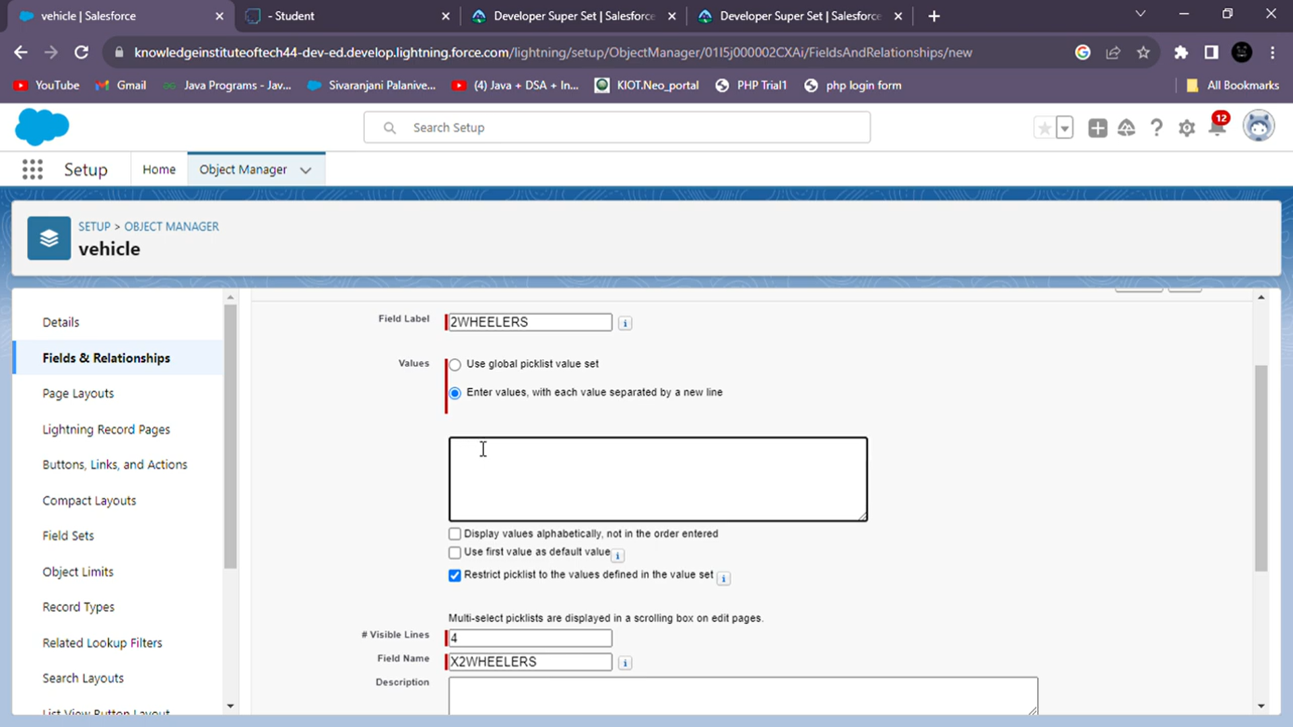

Slide 10
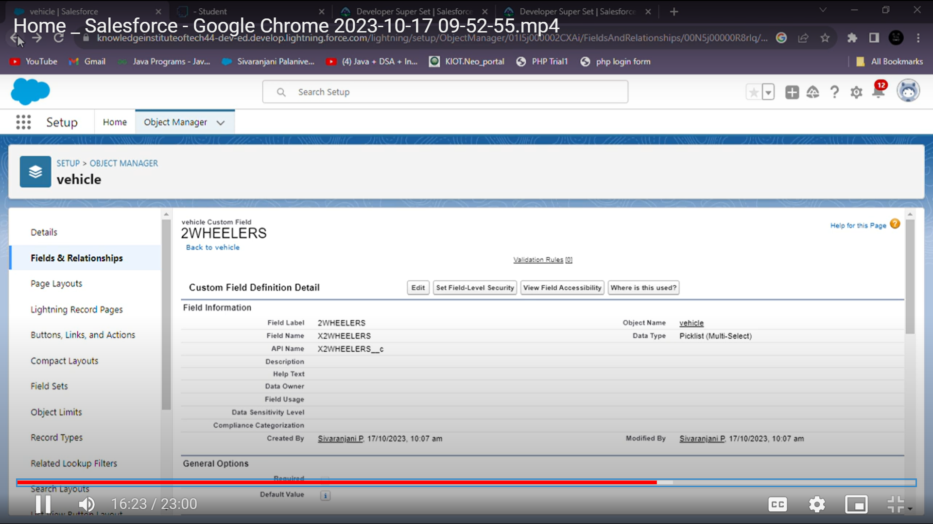
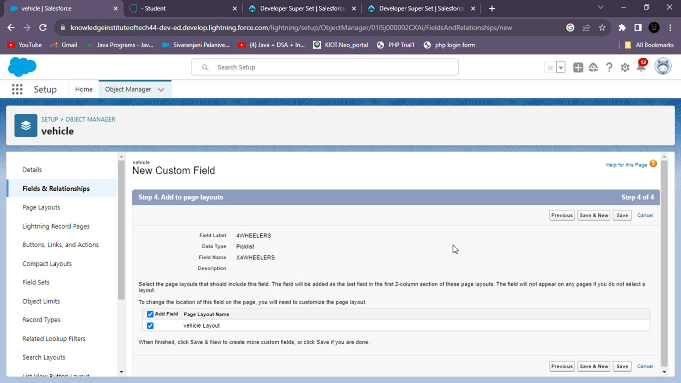

Slide 11
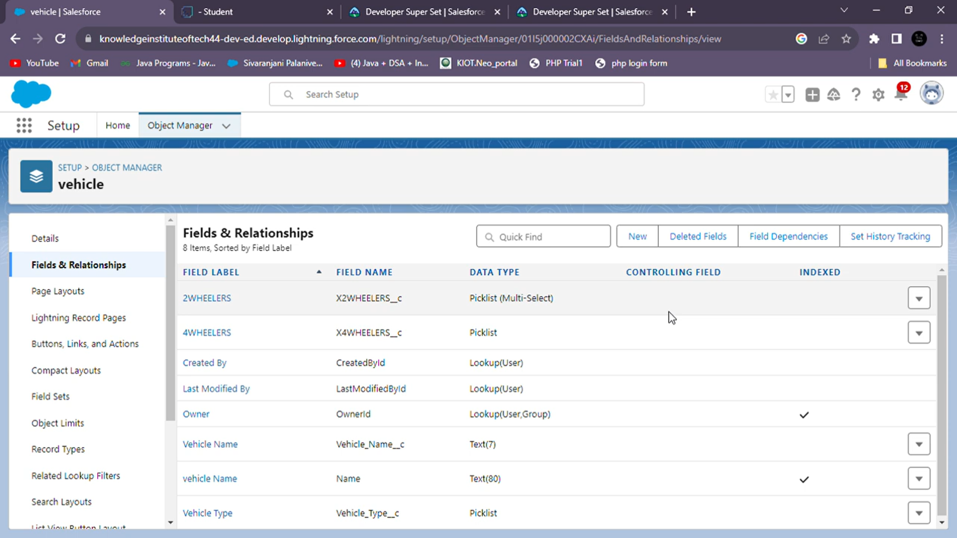

Slide 12
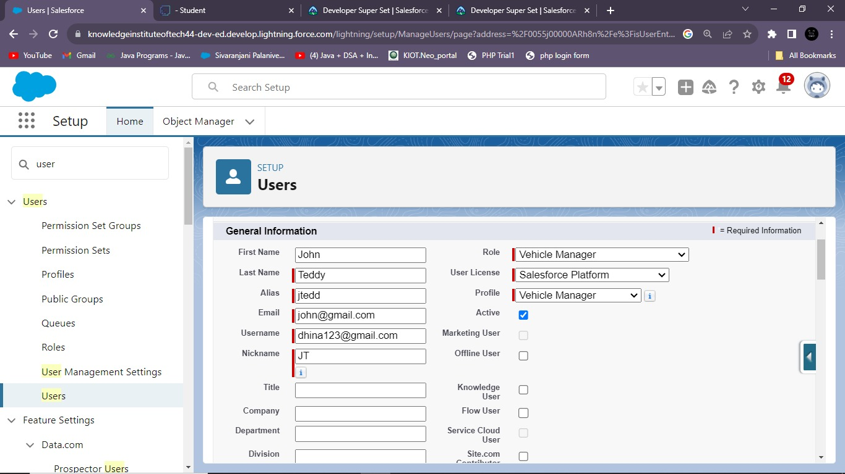
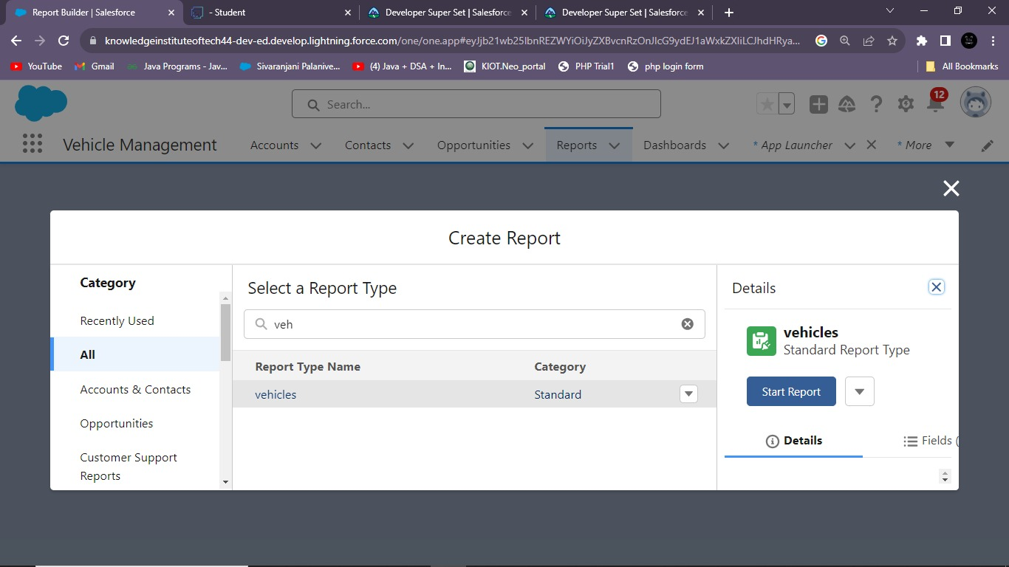

Slide 13
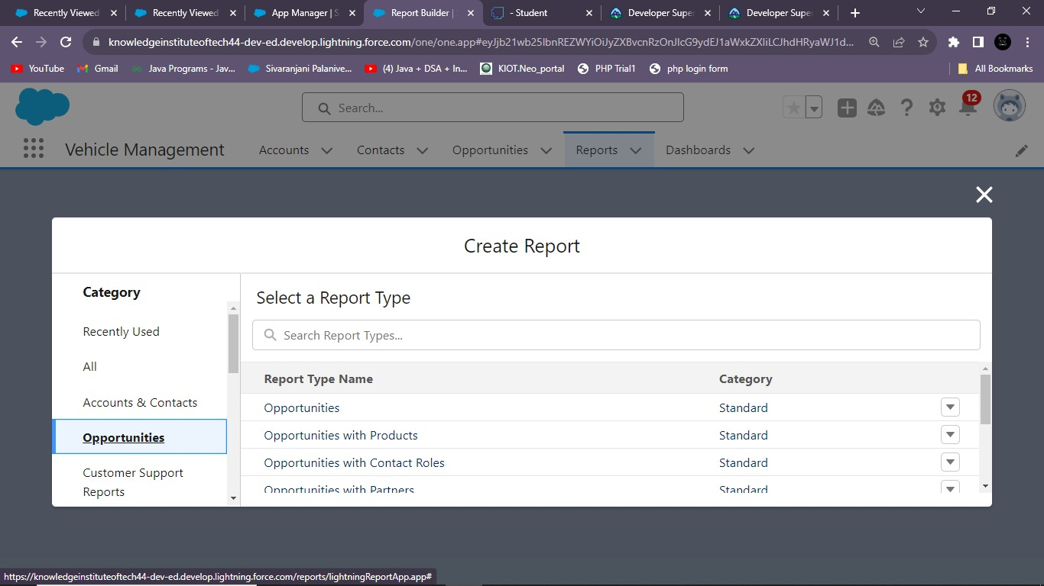
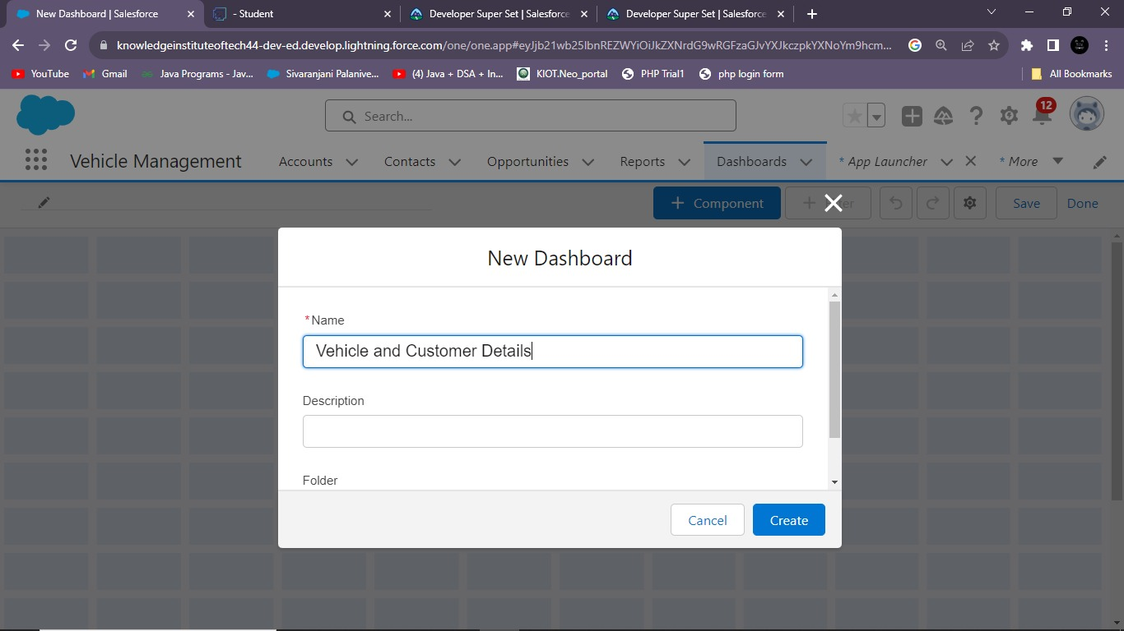

Slide 14
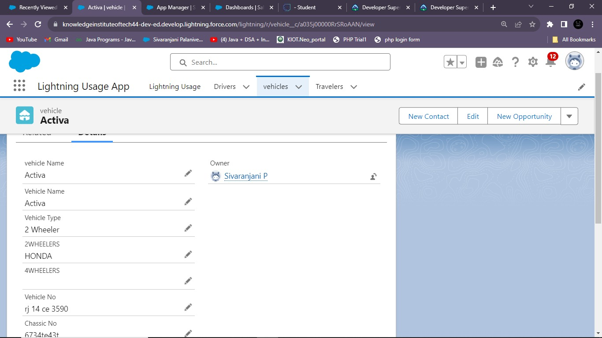
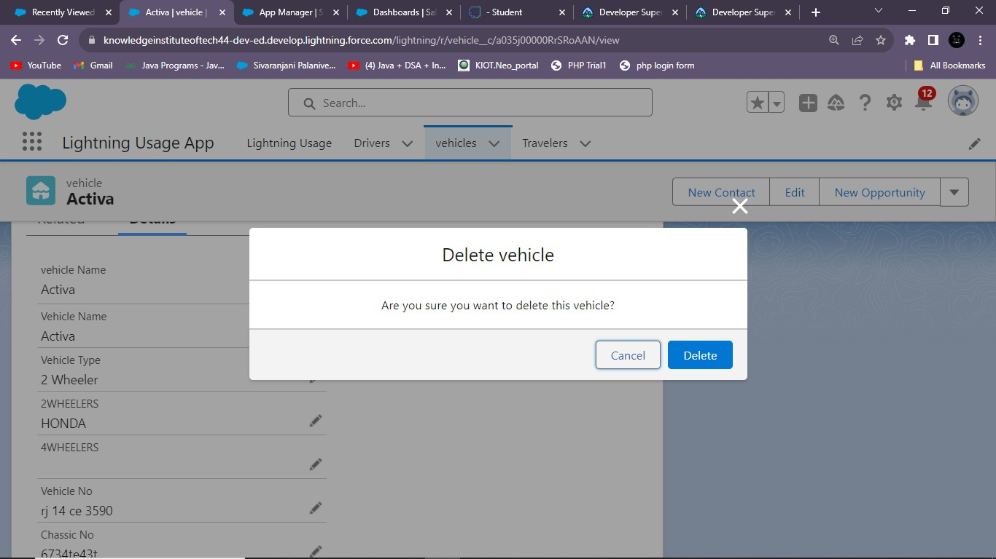

Slide 15
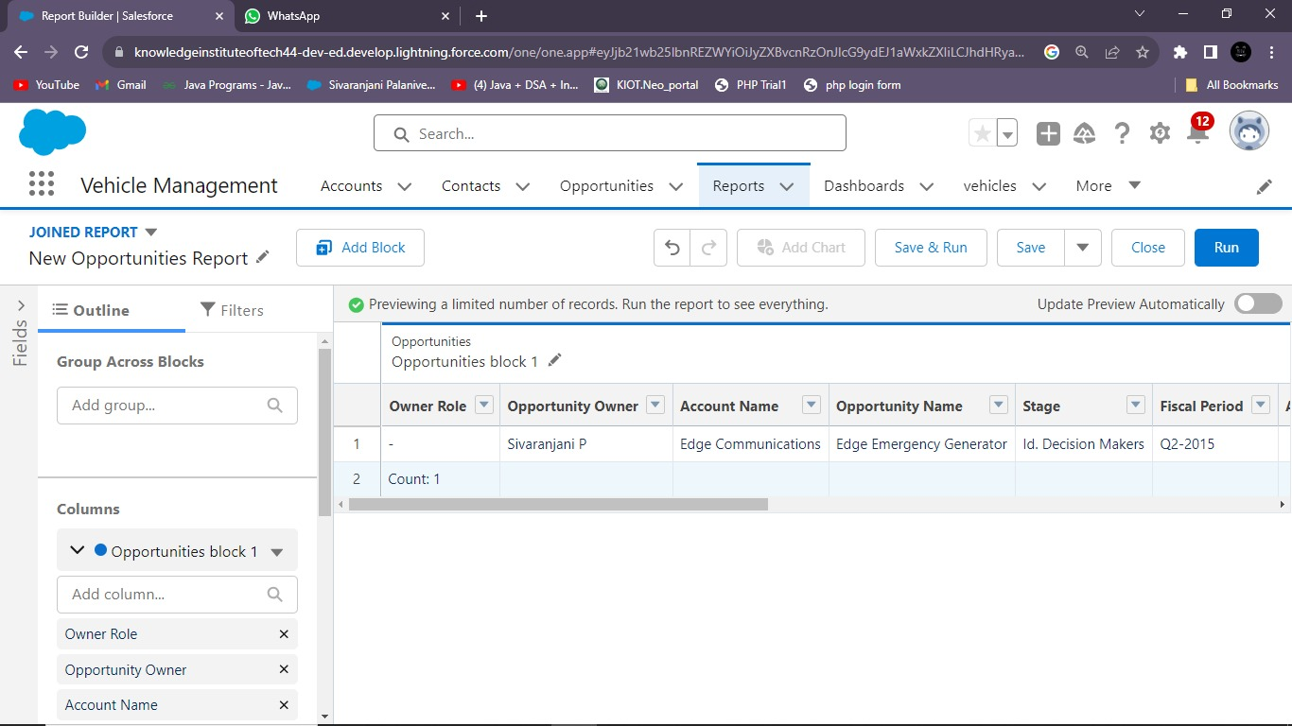
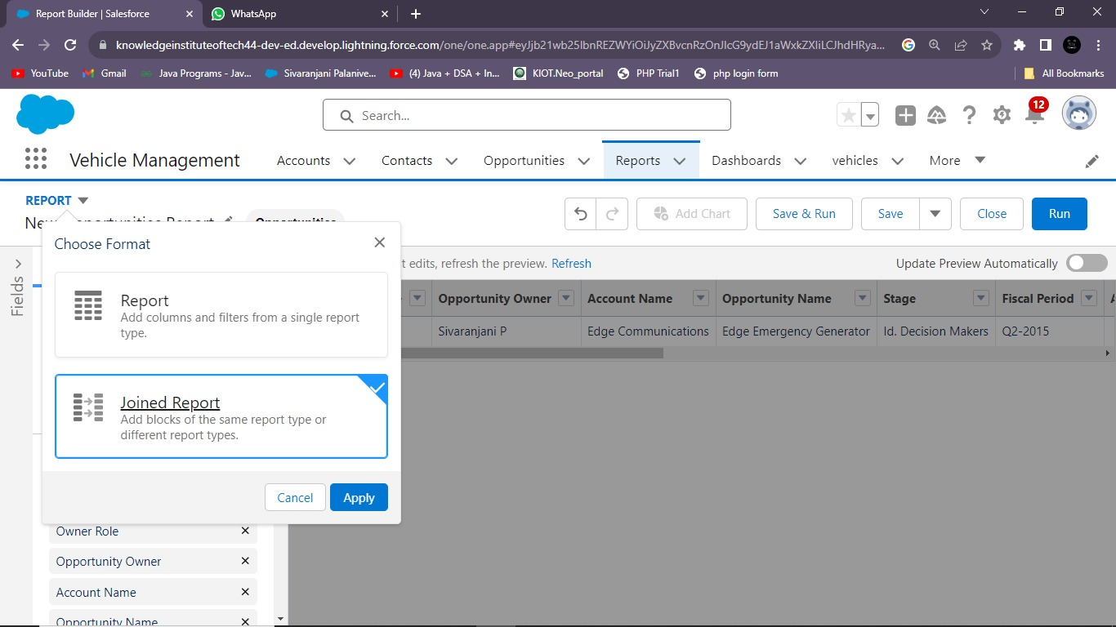

Slide 16
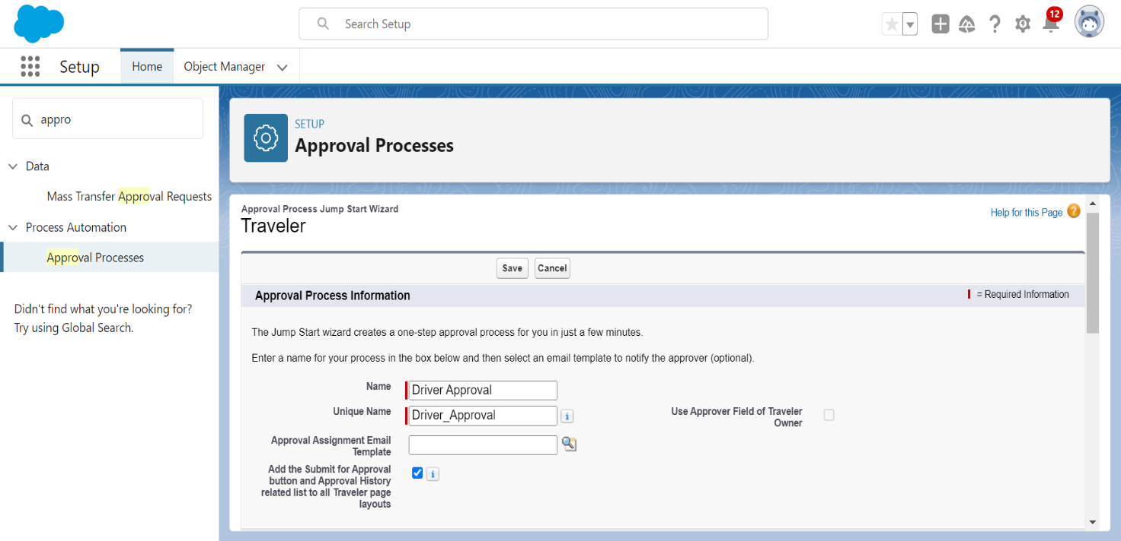

Slide 17
GitHub Link :
https://github.com/jo-canva/naanmudhalvan-2
Project Video Demo Link : https://drive.google.com/file/d/1ouUiqHCLZacEYYBcJbQj7tnohF1yKa-z/view?usp=sharing

Slide 18
Thank you

